Slide 1



The CREIGHTON MODEL FertilityCareTM System
Worldwide FertilityCare™ Week • March 22-28, 2026 • FertilityCare™ Centers of America • www.fertilitycare.org

Slide 2

The most important investment you’ll ever make
The CREIGHTON MODEL FertilityCareTM System
Worldwide FertilityCare™ Week • March 22-28, 2026 • FertilityCare™ Centers of America • www.fertilitycare.org

Slide 3

The CREIGHTON MODEL FertilityCareTM System
The most important investment you’ll ever make
Worldwide FertilityCare™ Week • March 22-28, 2026 • FertilityCare™ Centers of America • www.fertilitycare.org

Slide 4

The CREIGHTON MODEL FertilityCareTM System
The most important investment you’ll ever make
Worldwide FertilityCare™ Week • March 22-28, 2026 • FertilityCare™ Centers of America • www.fertilitycare.org

Slide 5

The CREIGHTON MODEL FertilityCareTM System
The most important investment you’ll ever make
Worldwide FertilityCare™ Week • March 22-28, 2026 • FertilityCare™ Centers of America • www.fertilitycare.org

Slide 6

When You Want to
Take Care of Your Fertility,
You Have Everything You Need:
Learn to Hear What Your Body is Telling You with
The CREIGHTON MODEL FertilityCareTM System
Worldwide FertilityCare™ Week • March 22-28, 2026 • FertilityCare™ Centers of America • www.fertilitycare.org

Slide 7

AR
The CREIGHTON MODEL FertilityCareTM System &
to Celebrate the Goodness & Beauty of a Woman’s Fertility in any Vocation
Worldwide FertilityCare™ Week • March 22-28, 2026 • FertilityCare™ Centers of America • www.fertilitycare.org

Slide 8

The CREIGHTON MODEL FertilityCareTM System
No Third Party Directing Your Intimacy
Worldwide FertilityCare™ Week • March 22-28, 2026 • FertilityCare™ Centers of America • www.fertilitycare.org

Slide 9

The CREIGHTON MODEL FertilityCareTM System
The most accurate System in the world & it starts with
Worldwide FertilityCare™ Week • March 22-28, 2026 • FertilityCare™ Centers of America • www.fertilitycare.org

Slide 10

The most accurate System in the world & it starts with
The CREIGHTON MODEL FertilityCareTM System & NaProTECHNOLOGY®
Worldwide FertilityCare™ Week • March 22-28, 2026 • FertilityCare™ Centers of America • www.fertilitycare.org

Slide 11

Freedom from Refills &
Unnecessary Medical Interventions with
The CREIGHTON MODEL FertilityCareTM System & NaProTECHNOLOGY®
Worldwide FertilityCare™ Week • March 22-28, 2026 • FertilityCare™ Centers of America • www.fertilitycare.org

Slide 12

Freedom from Refills &
Unnecessary Medical Interventions with
The CREIGHTON MODEL FertilityCareTM System
Worldwide FertilityCare™ Week • March 22-28, 2026 • FertilityCare™ Centers of America • www.fertilitycare.org

Slide 13

No Need to Medicate, Implant or Change
The CREIGHTON MODEL FertilityCareTM System & NaProTECHNOLOGY®
are
Worldwide FertilityCare™ Week • March 22-28, 2026 • FertilityCare™ Centers of America • www.fertilitycare.org

Slide 14
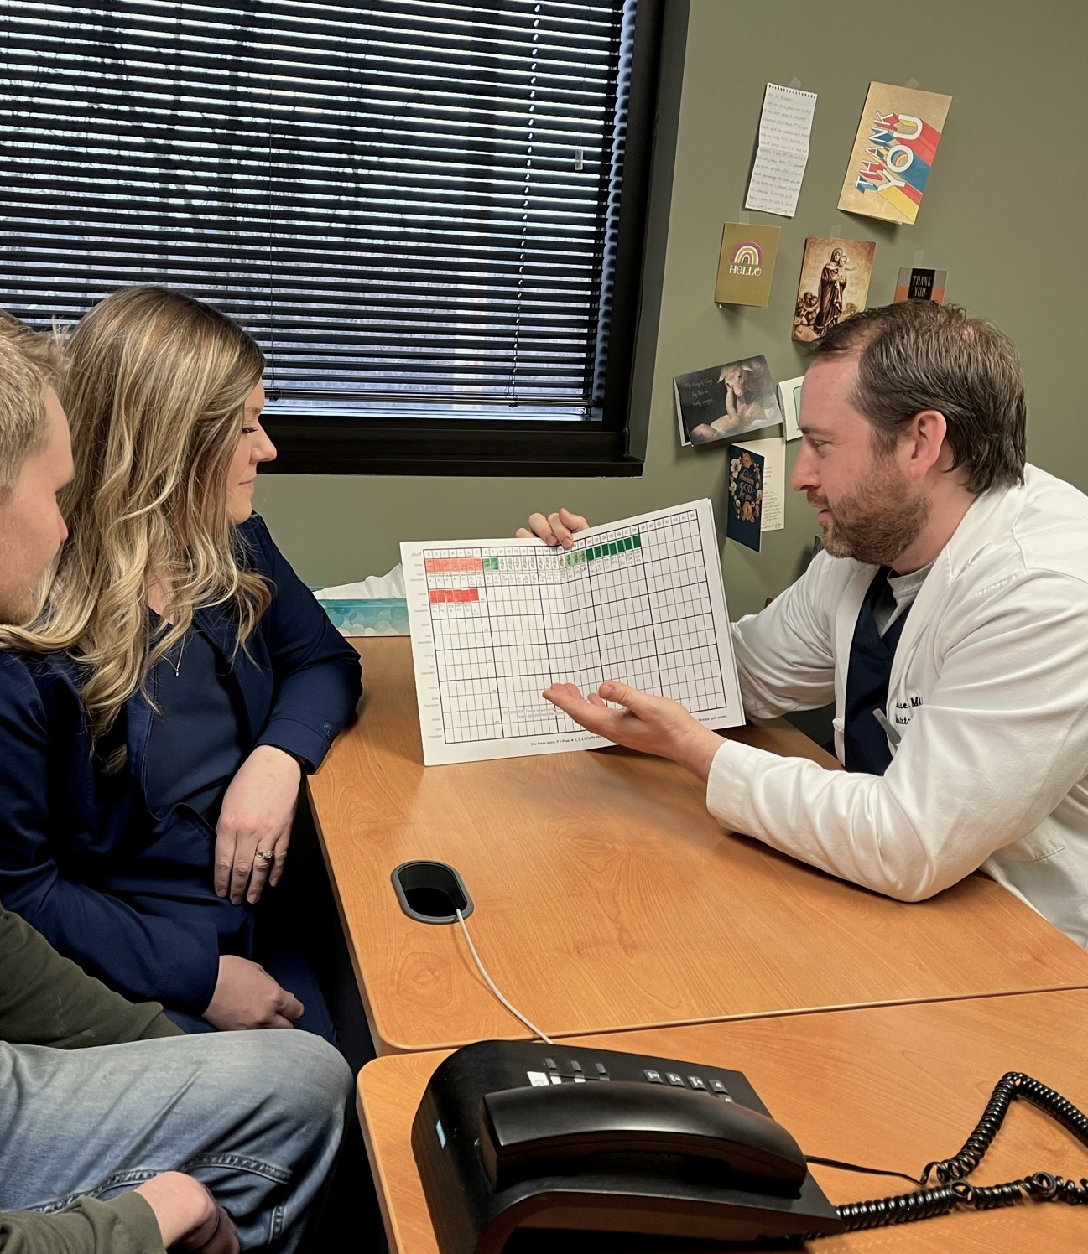
Understood with
The CREIGHTON MODEL FertilityCareTM System
Restored with NaProTECHNOLOGY®
Worldwide FertilityCare™ Week • March 22-28, 2026 • FertilityCare™ Centers of America • www.fertilitycare.org

Slide 15

The CREIGHTON MODEL FertilityCareTM System
The Most Powerful Tool For Your Fertility Journey
Worldwide FertilityCare™ Week • March 22-28, 2026 • FertilityCare™ Centers of America • www.fertilitycare.org

Slide 16

The CREIGHTON MODEL FertilityCareTM System
The Method You
Never Outgrow
Worldwide FertilityCare™ Week • March 22-28, 2026 • FertilityCare™ Centers of America • www.fertilitycare.org

Slide 17

In a World Full of Gadgets Keep Your Connection
The CREIGHTON MODEL FertilityCareTM System
& SPICE
Worldwide FertilityCare™ Week • March 22-28, 2026 • FertilityCare™ Centers of America • www.fertilitycare.org

Slide 18

God’s Perfect Design for your Fertility
Learn More With
The CREIGHTON MODEL FertilityCareTM System
Worldwide FertilityCare™ Week • March 22-28, 2026 • FertilityCare™ Centers of America • www.fertilitycare.org

Slide 19
The CREIGHTON MODEL FertilityCareTM System
To learn more contact us at:
Worldwide FertilityCare™ Week • March 22-28, 2026 • FertilityCare™ Centers of America • www.fertilitycare.org

Slide 20
The CREIGHTON MODEL FertilityCareTM System
To Learn More Contact Us At:
Worldwide FertilityCare™ Week • March 22-28, 2026 • FertilityCare™ Centers of America • www.fertilitycare.org

